Slide 1
Moses messes up

Slide 2
Worship
Focus on God.
Listen to your teachers (cos they are helping you to focus).
Be sincere.
Colossians 3:23
“Whatever you do, work at it wholeheartedly as though you were doing it for the Lord and not merely for people.”

Slide 3
To God be the glory (hymn)
To God be the glory, great things He hath done,
So loved He the world that He gave us His Son,
Who yielded His life our redemption to win,
And opened the life-gate that all may go in.
Praise the Lord, praise the Lord,
Let the earth hear His voice;
Praise the Lord, praise the Lord,
Let the people rejoice;
Oh, come to the Father, through Jesus the Son,
And give Him the glory; great things He hath done.
Oh, perfect redemption, the purchase of blood,
To every believer the promise of God;
The vilest offender who truly believes,
That moment from Jesus a pardon receives.
Great things He hath taught us, great things He hath done,
And great our rejoicing through Jesus the Son;
But purer, and higher, and greater will be
Our wonder, our transport when Jesus we see.
Big Words:
Redemption = buying back humans at a cost
Vilest = most vile = most wicked/evil
Pardon = wiping away your criminal record
Hath = the respectful version of “have”
Transport = overwhelmed with joy

Slide 4
https://www.youtube.com/watch?v=-15v9iworAU

Slide 5
RECAP

Slide 6
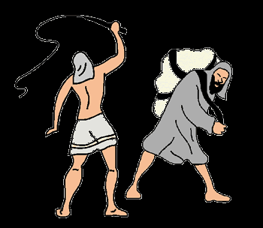
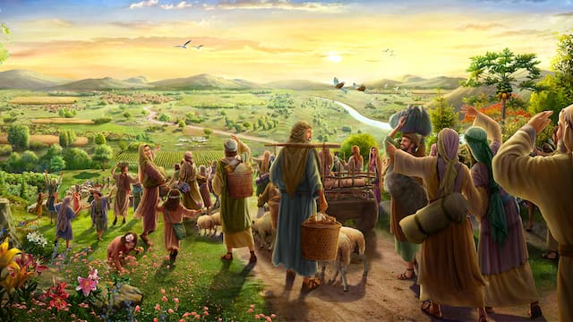
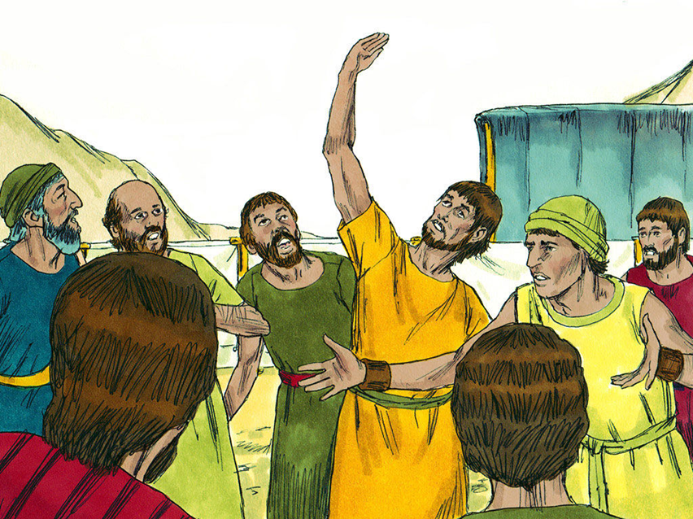
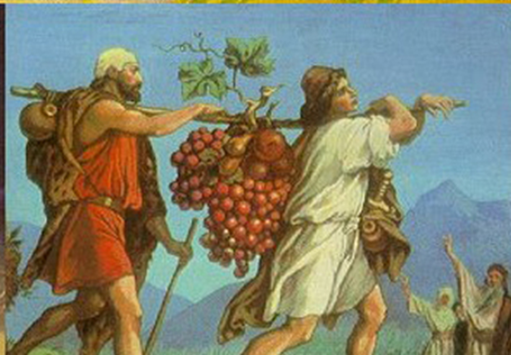
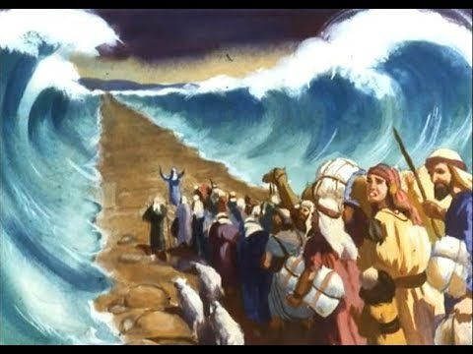
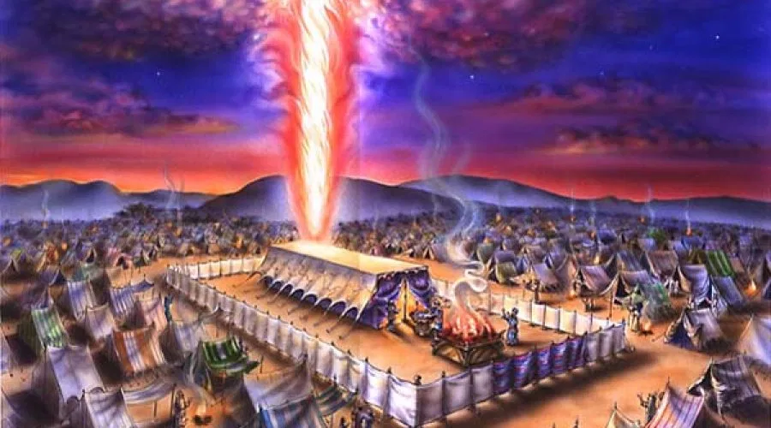
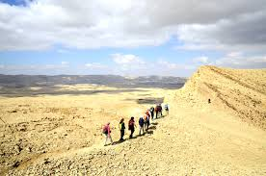
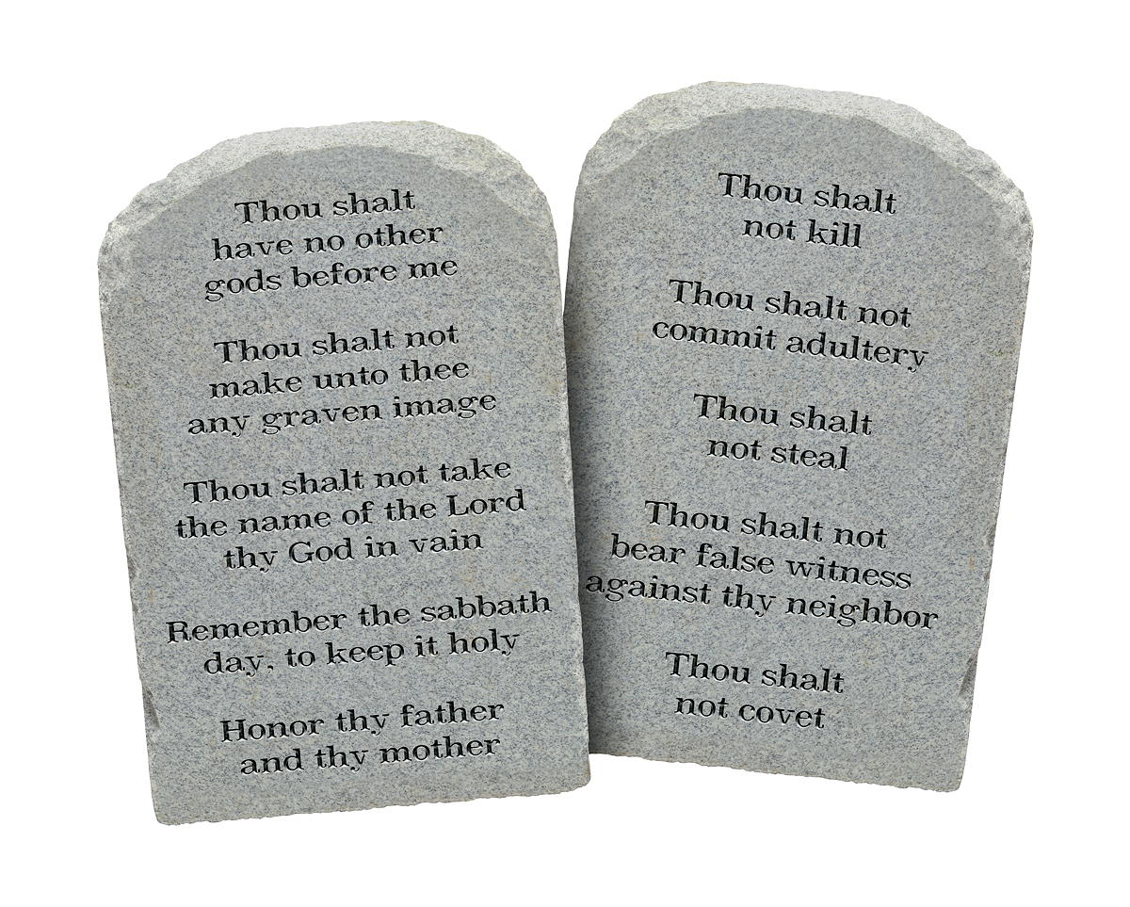
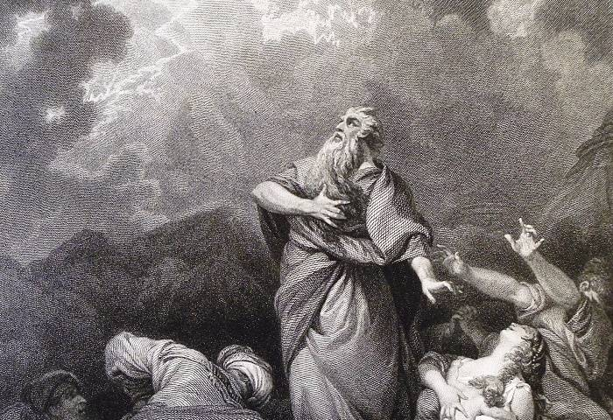
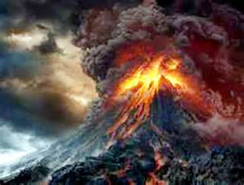
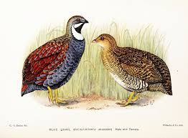
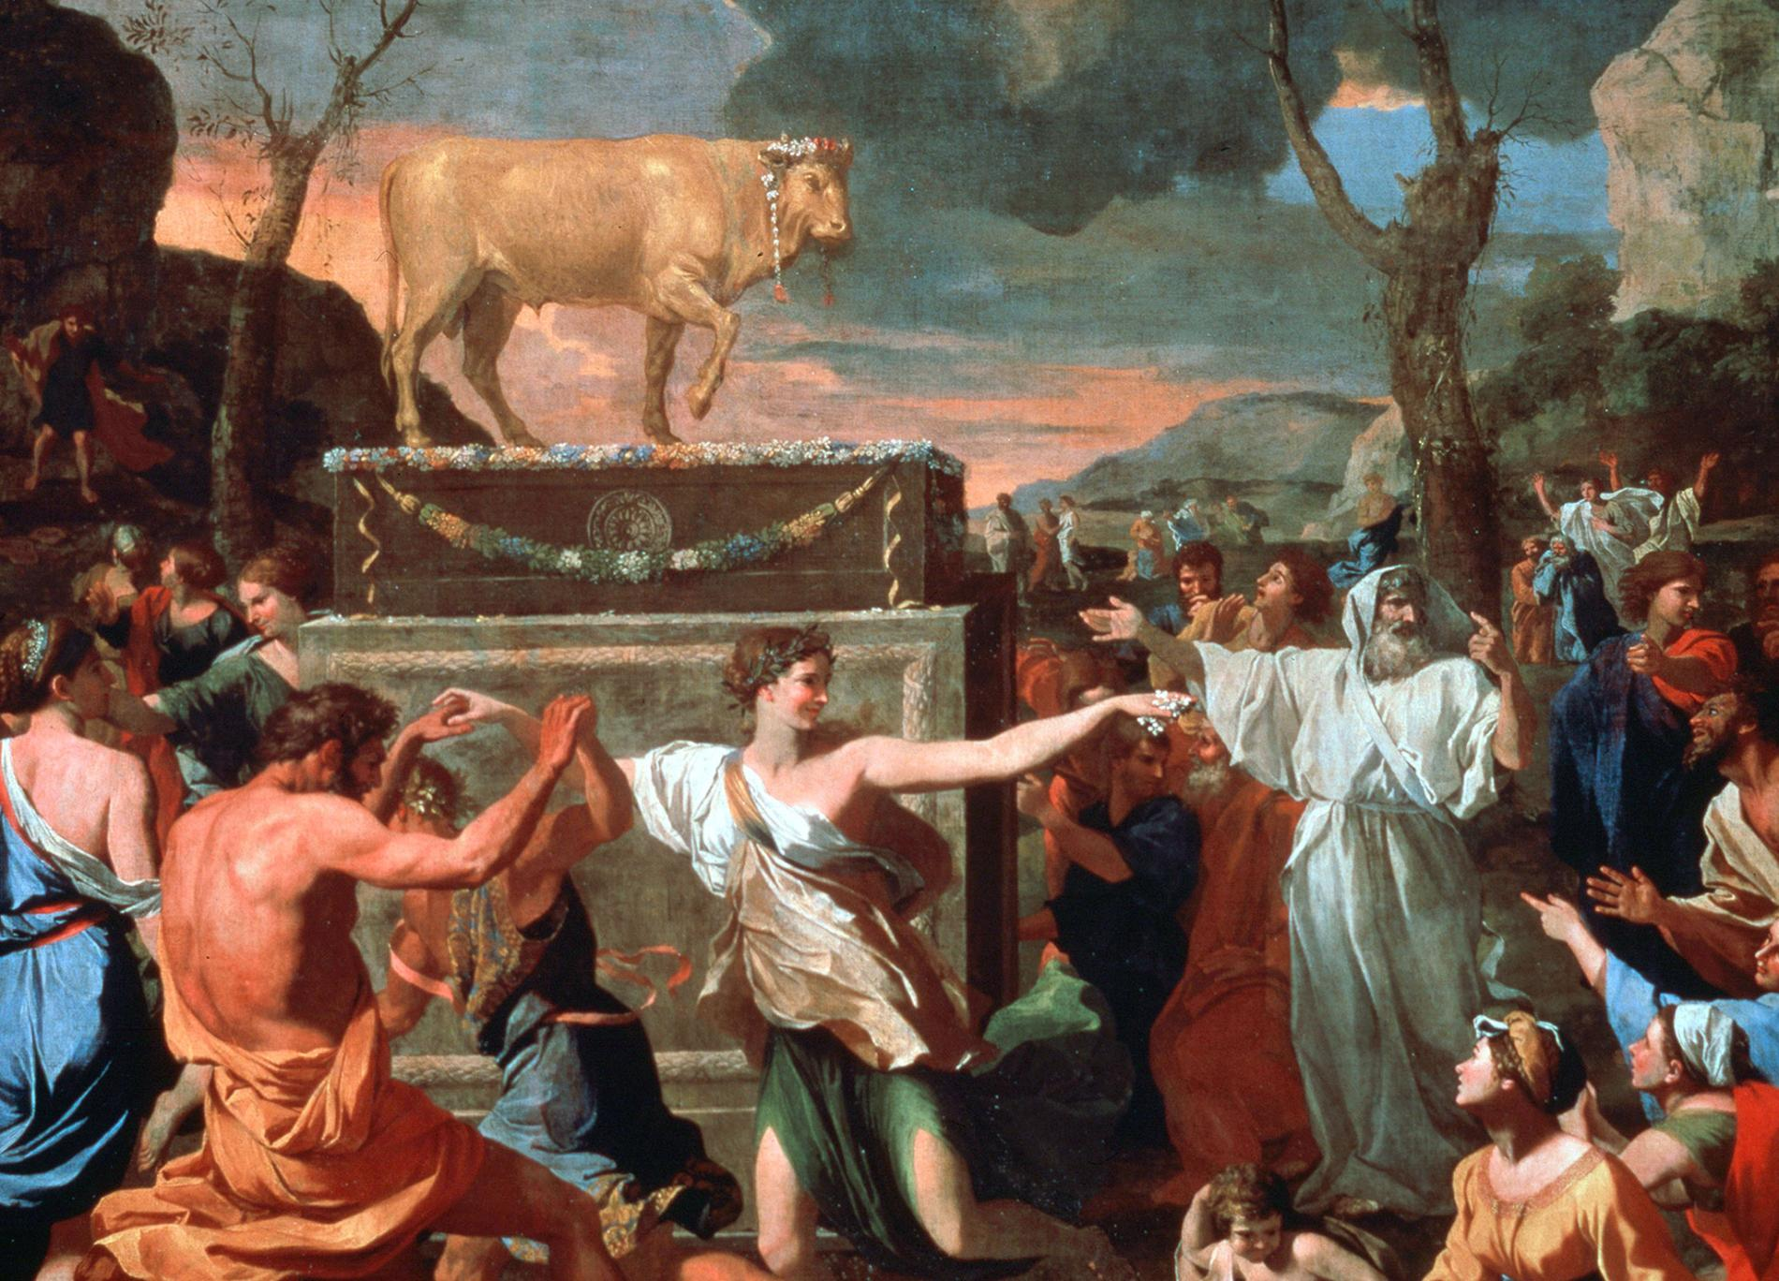
“EXODUS”
40 years punishment

Slide 7
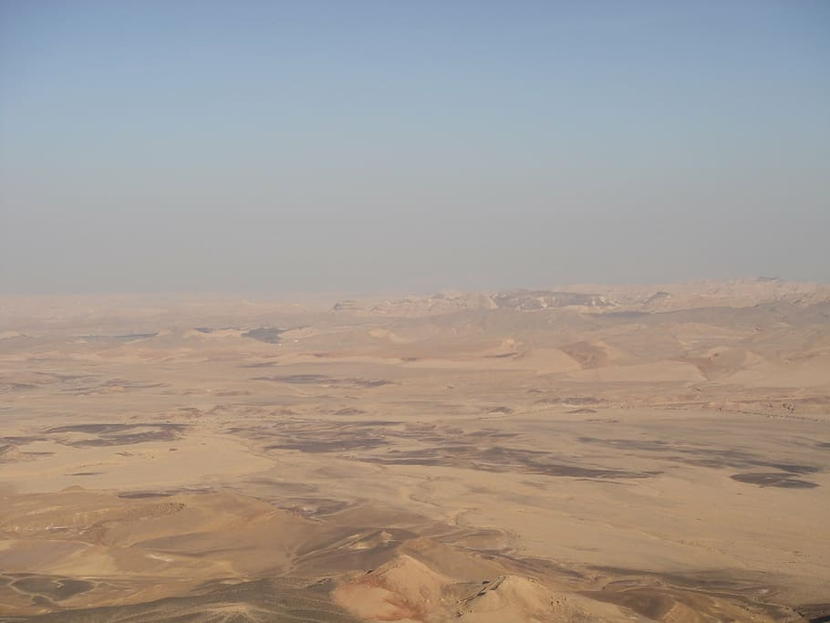

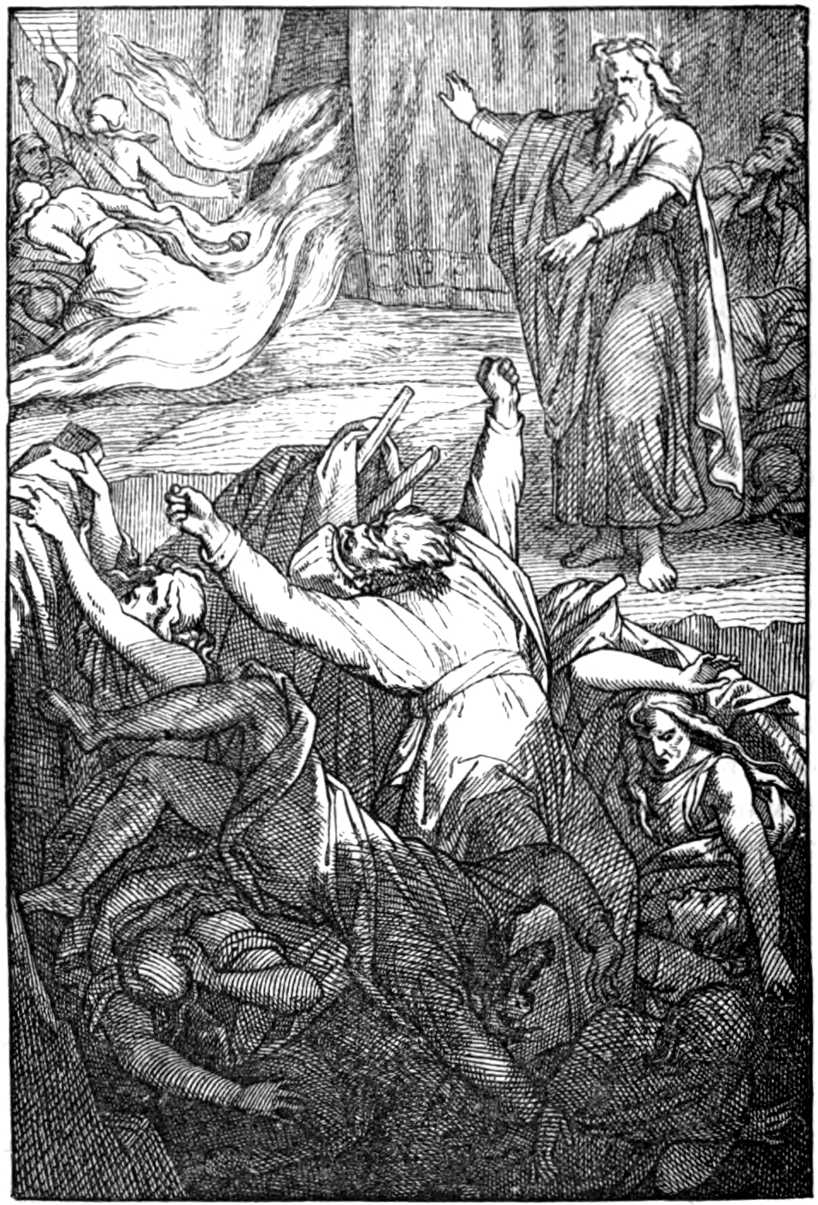
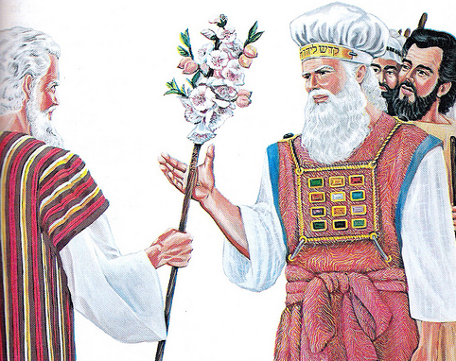
The Promised Land
“NUMBERS”
The Desert
40 years punishment
In the desert
New generation approach the Promised Land
Adults all died for their sin

Slide 8
One of the saddest events in the old testament happened…

Slide 9
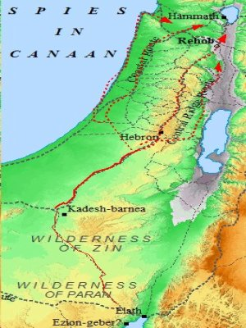
40 years AGO…
Where did Israel wait while they sent in the 12 spies?
Where did the people rebel against God that resulted in the 40 years exile in the desert?

Slide 10
40 years later, the children have grown up…
NUMBERS 20 1In the first month, the whole congregation of Israel entered the Wilderness of Zin and stayed in Kadesh. There Miriam died and was buried.
2Now there was no water for the congregation,
Would the Israelites have felt excited?
If you were there, what would you have told Israel to do?

Slide 11
Israel rebels (again?!?!)
NUMBERS 20 1In the first month, the whole congregation of Israel entered the Wilderness of Zin and stayed in Kadesh. There Miriam died and was buried.
2Now there was no water for the congregation,
so they gathered against Moses and Aaron. 3The people quarreled with Moses and said, “If only we had perished with our brothers before the LORD! 4Why have you brought the LORD’s assembly into this wilderness for us and our livestock to die here? 5Why have you led us up out of Egypt to bring us to this wretched place? It is not a place of grain, figs, vines, or pomegranates—and there is no water to drink!”
Was this the right thing for them to have done? Why?

Slide 12
How did god respond to Israel’s rebellion?
6Then Moses and Aaron went from the presence of the assembly to the entrance to the Tent of Meeting. They fell facedown, and the glory of the LORD appeared to them. 7And the LORD said to Moses, 8“Take the staff and assemble the congregation. You and your brother Aaron are to speak to the rock while they watch, and it will pour out its water. You will bring out water from the rock and provide drink for the congregation and their livestock.”
What did God command Moses to do?
What do you think Moses did?

Slide 13
Follow the steps GAME

Slide 14
Round 1
FORWARD 3
RIGHT 2
BACK -1
RIGHT 2
BACK -3
LEFT -4
FORWARD 1

Slide 15
Round 2
BACK -2
RIGHT 2
BACK -1
RIGHT 1
FORWARD 1
LEFT -3
FORWARD 1

Slide 16
How did god respond to Israel’s rebellion?
6Then Moses and Aaron went from the presence of the assembly to the entrance to the Tent of Meeting. They fell facedown, and the glory of the LORD appeared to them. 7And the LORD said to Moses, 8“Take the staff and assemble the congregation. You and your brother Aaron are to speak to the rock while they watch, and it will pour out its water. You will bring out water from the rock and provide drink for the congregation and their livestock.”
What did God command Moses to do?
What do you think Moses did?

Slide 17
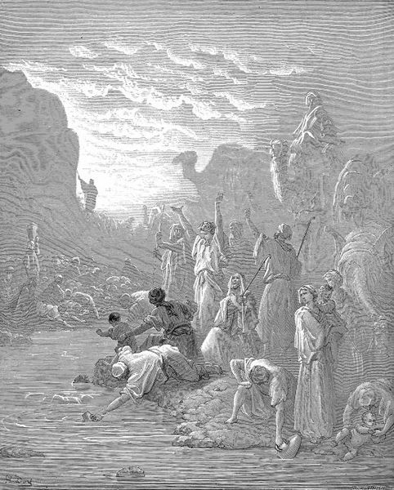
MOSES REBELS!?
I will bring out the water for you (not God)
9So Moses took the staff from the LORD’s presence, just as he had been commanded. 10Then Moses and Aaron gathered the assembly in front of the rock, and Moses said to them, “Listen now, you rebels, must we bring you water out of this rock?” 11Then Moses raised his hand and struck the rock twice with his staff, so that a great amount of water gushed out, and the congregation and their livestock were able to drink.
Had Moses ever called Israel “rebels”?
What bad thing did Moses do?

Slide 18
How did god deal with Moses’s rebellion?
12But the LORD said to Moses and Aaron, “Because you did not trust Me to show My holiness in the sight of the Israelites, you will not bring this assembly into the land that I have given them.” 13These were the waters of Meribah, where the Israelites quarreled with the LORD, and He showed His holiness among them.
The old generation of Israelites had rebellion in their hearts
And Moses also had rebellion / sin in his heart!

Slide 19
Israel’s human saviour fell short

Slide 20
But Jesus is the perfect saviour!

Slide 21
Big IDEA
Israel rebelled yet again. Moses was so angry that he did not trust God enough to obey God’s instructions.
We must completely trust God and live in obedience to his word. We all need God’s help to do this.

